Slide 1
FAO
Felici Rocco
Silva Edoardo
Vitali Tommaso

Slide 2
Motivation slide
This app will help people to have a correct diet and eat the proper foods that supply their needs based on the calories burnt during the day, accounting what food they have at their disposal.
Ensuring and granting a correct personalized diet can prevent bad habits, and recipes based of what the user inputs prevent them from searching for the it themselves.
This app aim to have easier and more precise inputs than existing solutions, plus the main activity a human does everyday is walking.

Slide 3
Implementation
Pages are going to be implemented based of the step-app used in the course tutorials, including Navigation Drawer, intents and notifications.
Recipes and ingredients will have their own databases, to implement (possibly?) externally, in that case the app require an internet access to work.
The steps done will be held in local memory and converted in calories when requested using a specific formula.
The main algorithm will access databases and calories got from the last meal and search the possible recipe based on that and the available ingredients.
Notifications and data visualization (along with user’s informations) will be customizable in the dedicated setting page.

Slide 4
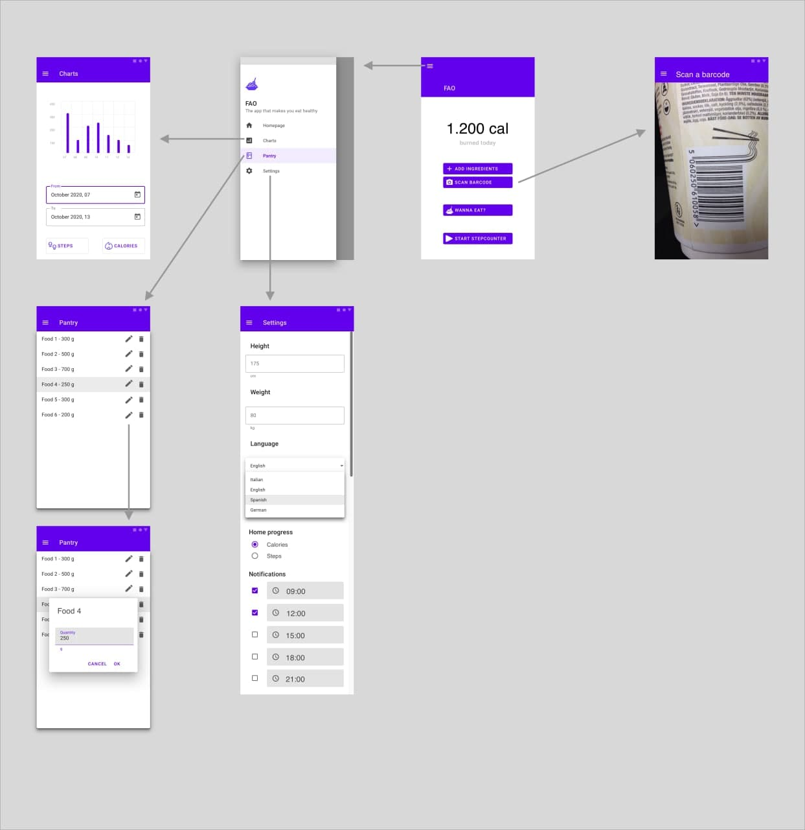
Storyboard

Slide 5
Thank you slide

